Slide 1
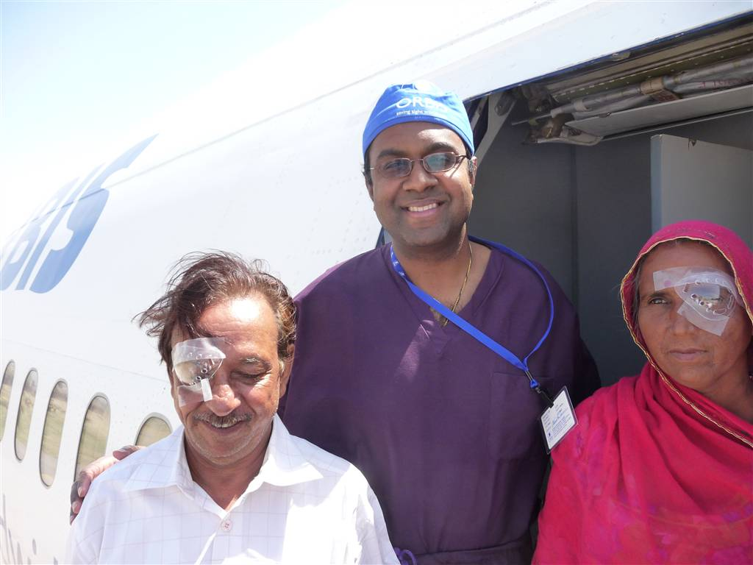
Postops Going Home in India

Slide 2
Operating without a Microscope in Africa

Slide 3
Teaching in Clinic in India

Slide 4
Pediatric Screening

Slide 5
Live Surgery

Slide 6
Greeting Patients on 1st Day

Slide 7
Teaching in Macha, Zambia

Slide 8
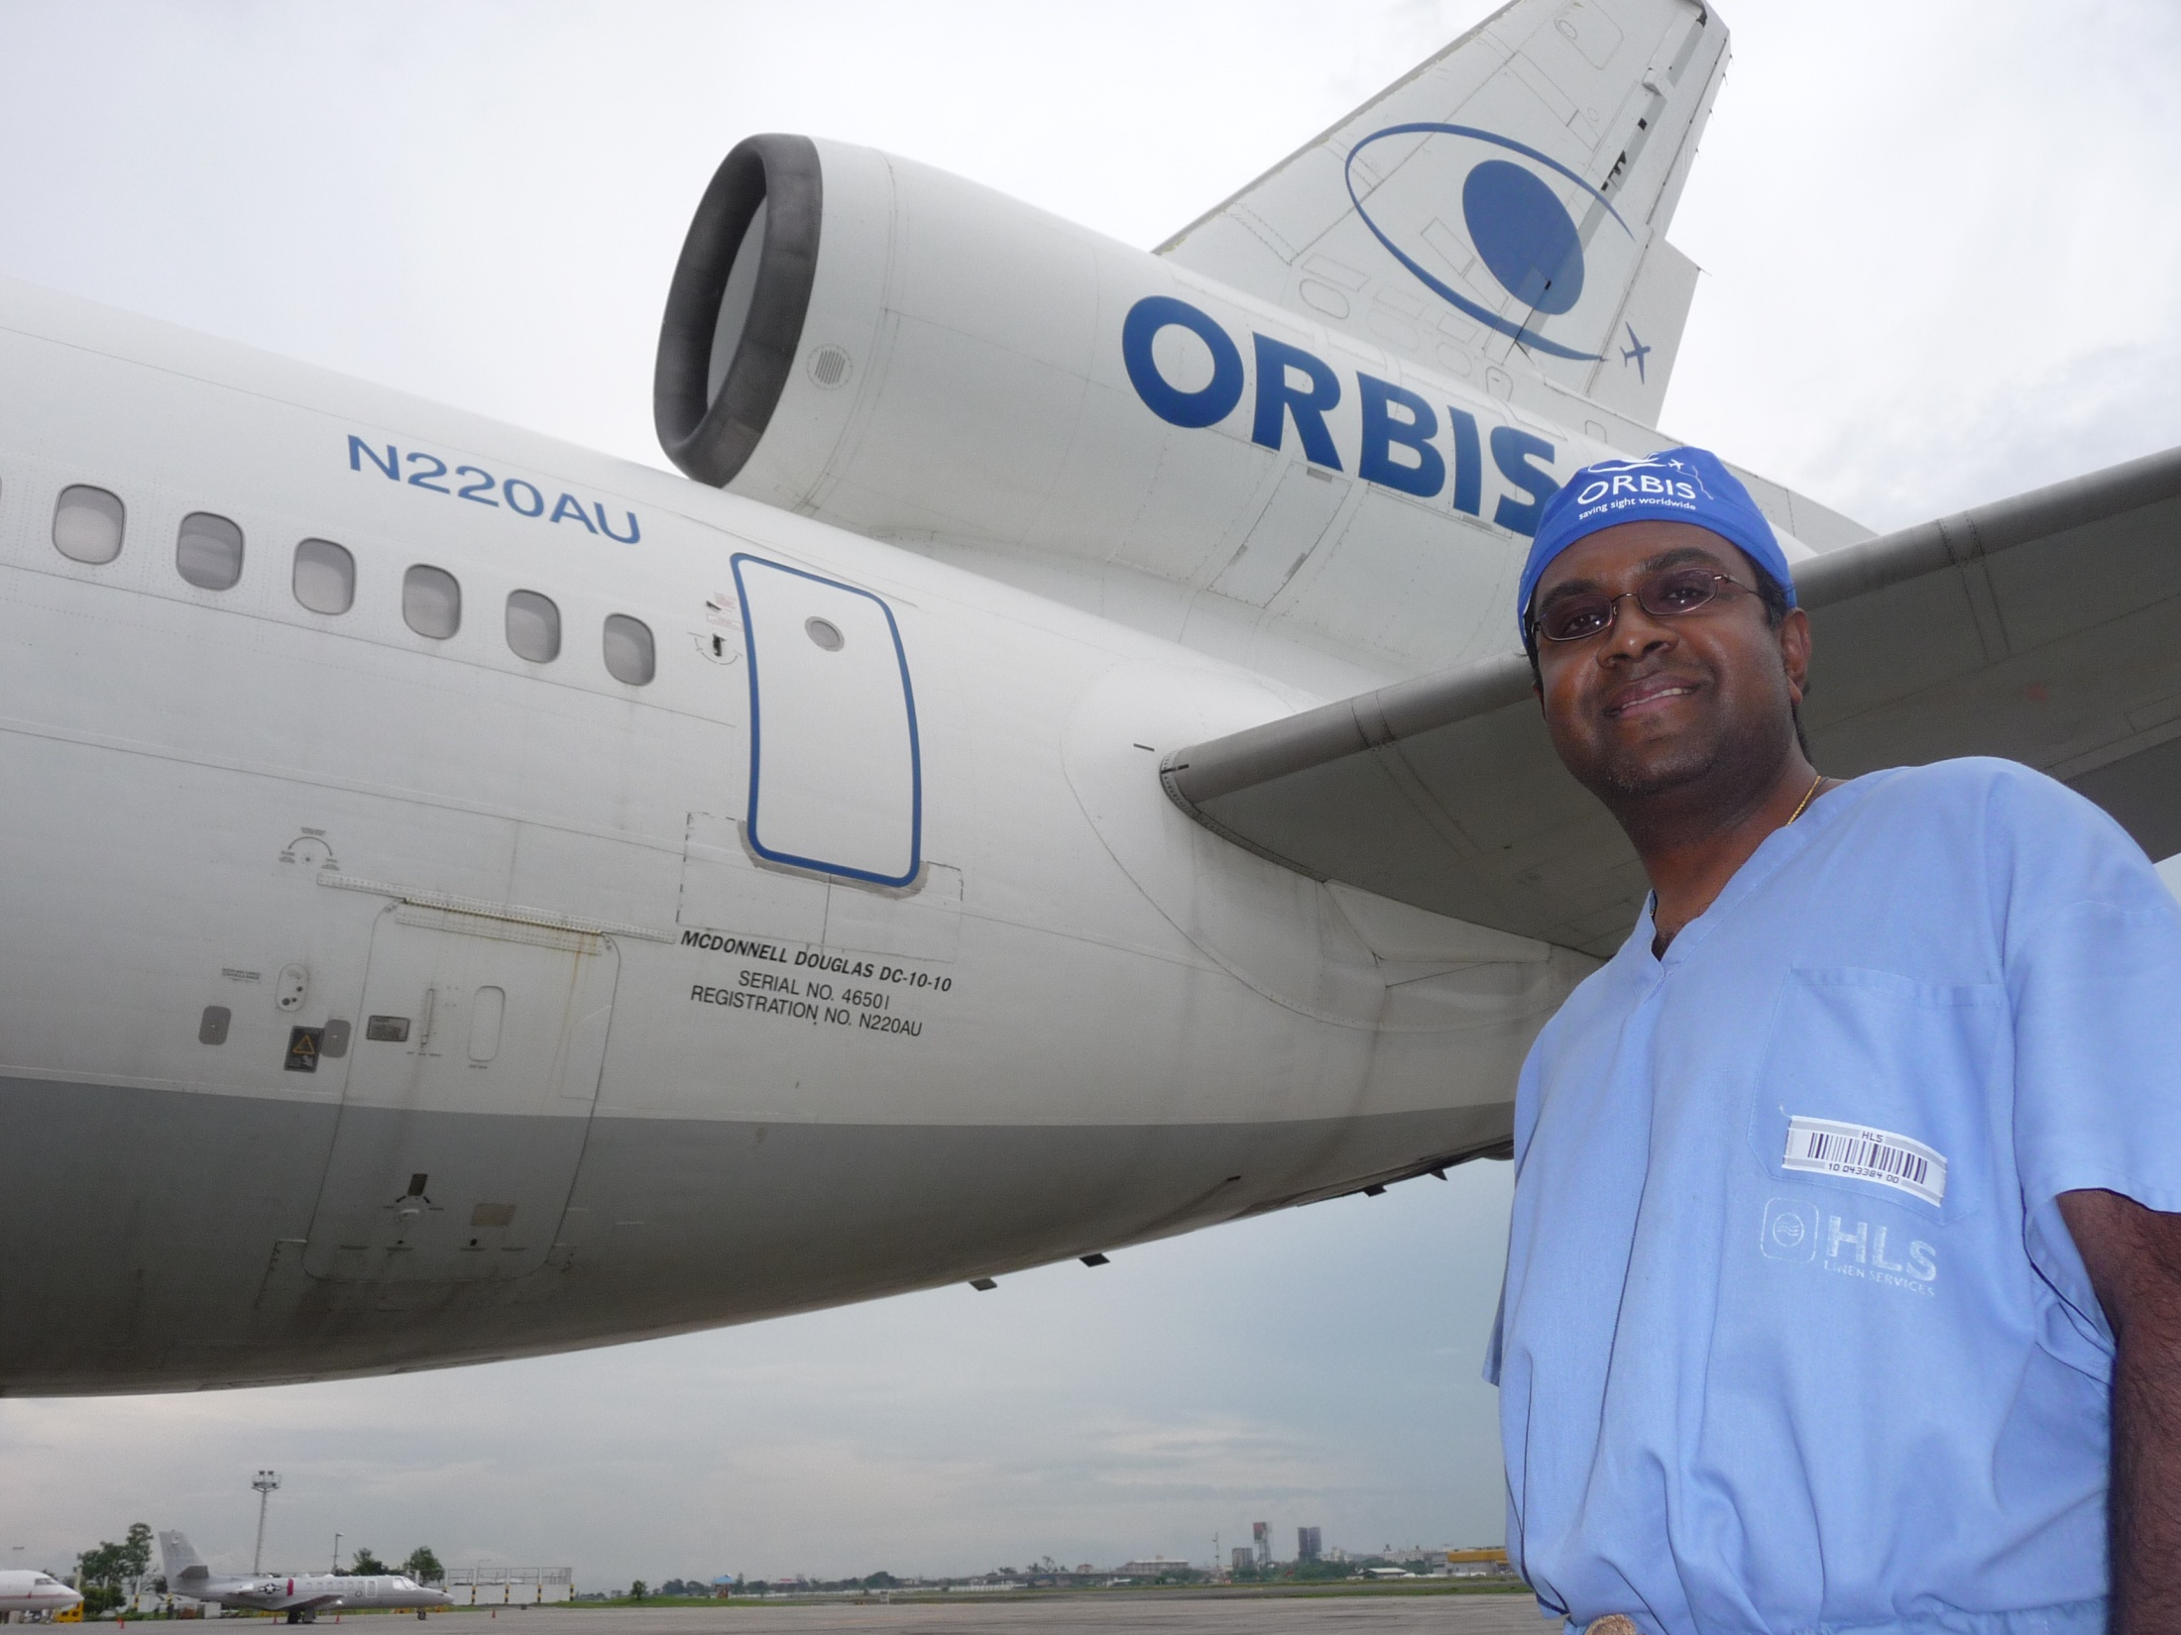
With ORBIS

Slide 9
With Hands-On Trainees

